Slide 1
Model/View/Controller

Slide 2
Model
Data values and logic to manipulate them
Observable
View
How the data are displayed
Observer
Controller
Receives data values and updates the Model

Slide 3
Model
A representation of the data with no concern for how it will appear to the user.
Temperature
getTemp()
setTemp(float t)
32.0
class TemperatureModel

Slide 4
Model
A representation of the data with no concern for how it will appear to the user.
Temperature
addObserver()
setChanged()
notifyObservers()
…
getTemp()
setTemp(float t)
32.0
class TemperatureModel extends Observable {

Slide 5
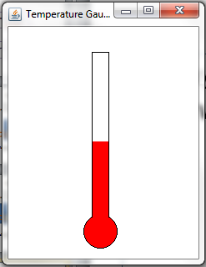
View
Display of the data using GUI components by observing the Model.
class Thermometer implements Observer {

Slide 6
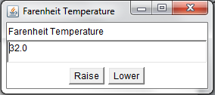
Controller
A Listener that responds to events and updates the Model.
For example, push a button to raise the temperature one degree.

Slide 7
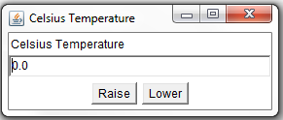
Temperature
32.0

Slide 8
Typical Temperature Class
public class TemperatureModel {
private double temperatureF = 32.0;
public double getF() {
return temperatureF;
}
public double getC(){
return (temperatureF - 32.0) * 5.0 / 9.0;
}
public void setF(double tempF)
{
temperatureF = tempF;
}
public void setC(double tempC)
{ temperatureF = tempC*9.0/5.0 + 32.0;
}
}

Slide 9
TemperatureModel
import java.util.Observable;
public class TemperatureModel extends Observable {
private double temperatureF = 32.0;
public double getF() {
return temperatureF;
}
public double getC(){
return (temperatureF - 32.0) * 5.0 / 9.0;
}
public void setF(double tempF)
{
temperatureF = tempF;
setChanged();
notifyObservers();
}
public void setC(double tempC)
{ temperatureF = tempC*9.0/5.0 + 32.0;
setChanged();
notifyObservers();
}
}

Slide 10
Controller (Listener)
import java.awt.event.ActionEvent;
import java.awt.event.ActionListener;
class UpListener implements ActionListener {
TemperatureModel model;
public UpListener(TemperatureModel m) {
model = m;
}
public void actionPerformed(ActionEvent e) {
model.setF(model.getF() + 1.0);
}
}
Notes:
model.setF(model.getF() + 1.0); //get the current tempF from model and plus 1 and set it to new temp to model.

Slide 11
import java.awt.*;
import java.awt.event.*;
abstract class TemperatureGUI implements java.util.Observer {
private String label;
private TemperatureModel model;
private Frame temperatureFrame;
private TextField display = new TextField();
private Button upButton = new Button("Raise");
private Button downButton = new Button("Lower");
TemperatureGUI(String theLabel, TemperatureModel tModel, int h, int v) {
label = theLabel;
model = tModel;
Frame temperatureFrame;
temperatureFrame = new Frame(label);
temperatureFrame.add("North", new Label(label));
temperatureFrame.add("Center", display);
Panel buttons = new Panel();
buttons.add(upButton);
buttons.add(downButton);
temperatureFrame.add("South", buttons);
temperatureFrame.addWindowListener(new CloseListener());
model.addObserver(this); // Connect the View to the Model
temperatureFrame.setSize(200,100);
temperatureFrame.setLocation(h, v);
temperatureFrame.setVisible(true);
public void setDisplay(String s){
display.setText(s);}
public double getDisplay() {
return Double.valueOf(display.getText()).doubleValue();
}
continued…

Slide 12
public void addDisplayListener(ActionListener a){
display.addActionListener(a);}
public void addUpListener(ActionListener a){
upButton.addActionListener(a);}
public void addDownListener(ActionListener a){
downButton.addActionListener(a);}
actionPerformed from the DisplayListener class:
public void actionPerformed(ActionEvent e) {
double value = fg.getDisplay();
model.setF(value);
}

Slide 13
import java.awt.*;
import java.awt.event.*;
import java.util.Observable;
public class FarenheitGUI extends TemperatureGUI {
public FarenheitGUI(TemperatureModel model, int h, int v) {
super("Farenheit Temperature", model, h, v);
setDisplay(""+model.getF());
addUpListener(new UpListener(model));
addDownListener(new DownListener(model));
addDisplayListener(new DisplayListener(model,this));
}
public void update(Observable t, Object o)
// automatically called when the model is changed
{
setDisplay("" + model().getF());
}
}

